Slide 1
Practical Approaches to Mathematical Tools: Support Vector Machines
Craig Savage, PhD, MBA
Citizen Data Scientists - Melbourne

Slide 2
Disclosures

Slide 3
Introduction
To me and to this talk

Slide 4
Introduction: Personal
Education in technical fields and business
PhD in Electrical Engineering and MBA

Slide 5
Introduction: Personal
Education in technical fields and business
PhD in Electrical Engineering and MBA
Roughly 20 years experience in industry:
Defence
Biomedical Engineering
Banking (Risk)

Slide 6
Introduction: Personal
Education in technical fields and business
PhD in Electrical Engineering and MBA
Roughly 20 years experience in industry:
Defence
Biomedical Engineering
Banking (Risk)
Motivated by implementation of systems
Flight tests
Patient trials
Customer assessment
Goal is to have a measurable impact

Slide 7
Introduction: Support Vector Machines
Class of machine learning algorithms
Popular in the 1990’s/early 2000’s (which was when I was active in ML)
My “go-to” algorithm when people want “Machine Learning”
Classification, regression
Also anomaly detection – “one-class”
Podcast –
Discussion about preferred ML algorithms at the end
SVMs were mentioned – confirmation bias
From the data camp podcast
https://www.datacamp.com/community/podcast
Getting Your First Data Science Job (with Chris Albon)
Host (Hugo Bowne-Anderson): “Which do you prefer: Random Forests or Support Vector Machines?”
Guest (Chris Albon):
“Who uses Support Vector Machines? … I cannot think of a single case of someone who has used a support vector machine in production. Support Vector Machines are mathematically cool.”
“I cannot think of a single time that someone would choose a SVM over … anything! I don’t see that one moment when it’s that killer model to use.”

Slide 8

Introduction: Support Vector Machines
Class of machine learning algorithms
Popular in the 1990’s/early 2000’s (which was when I was active in ML)
My “go-to” algorithm when people want “Machine Learning”
Classification or regression
Podcast –
Discussion about preferred ML algorithms at the end
SVMs were mentioned – confirmation bias
From the data camp podcast
https://www.datacamp.com/community/podcast
Getting Your First Data Science Job (with Chris Albon)
Host (Hugo Bowne-Anderson): “Which do you prefer: Random Forests or Support Vector Machines?”
Guest (Chris Albon):
“Who uses Support Vector Machines? … I cannot think of a single case of someone who has used a support vector machine in production. Support Vector Machines are mathematically cool.”
“I cannot think of a single time that someone would choose a SVM over … anything! I don’t see that one moment when it’s that killer model to use.”

Slide 9
Introduction: Support Vector Machines
Class of machine learning algorithms
Popular in the 1990’s/early 2000’s (which was when I was active in ML)
My “go-to” algorithm when people want “Machine Learning”
Classification or regression
Podcast –
Discussion about preferred ML algorithms at the end
SVMs were mentioned – confirmation bias
From the data camp podcast
https://www.datacamp.com/community/podcast
Getting Your First Data Science Job (with Chris Albon)
Host (Hugo Bowne-Anderson): “Which do you prefer: Random Forests or Support Vector Machines?”
Guest (Chris Albon):
“Who uses Support Vector Machines? … I cannot think of a single case of someone who has used a support vector machine in production. Support Vector Machines are mathematically cool.”
“I cannot think of a single time that someone would choose a SVM over … anything! I don’t see that one moment when it’s that killer model to use.”
Goal: Give practical overview of strengths of Support Vector Machines

Slide 10

Introduction: Ulmer’s law
Dr Mel Ulmer – professor of Astronomy at Northwestern University
Ulmer’s Law: “For every equation you put in a talk, you lose 10% of your audience.”
Corollary: “Ulmer’s Law can be expressed as an equation, but you’d lose 10% of your audience.”
Test: Show equations without discussion

Slide 11
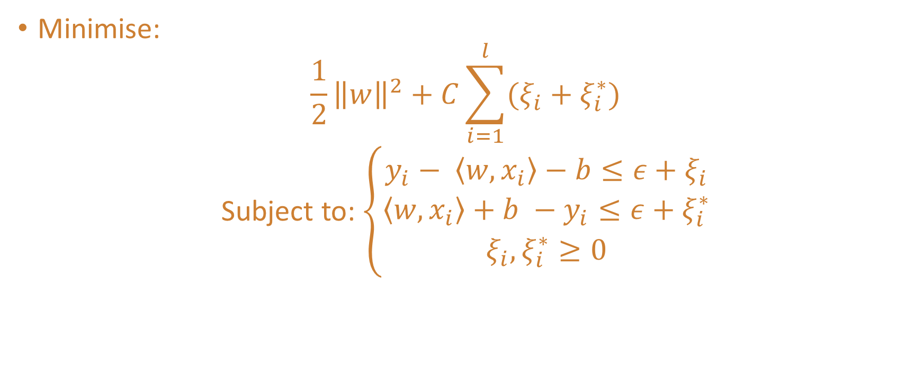
Introduction: Support Vector Machines
Minimise:
$$\frac{1}{2}{\left\|w\right\|}^{2}+C\sum_{i=1}^{l}{(ξ_{i}+ξ_{i}^{∗})}$$
Subject to:$\left\{\begin{matrix}y_{i}− \left\langle w,x_{i}\right\rangle −b≤ε+ξ_{i} \\ \left\langle w,x_{i}\right\rangle +b −y_{i}≤ε+ξ_{i}^{∗} \\ ξ_{i}, ξ_{i}^{∗}≥0\end{matrix}\right.$

Slide 12

Introduction: Support Vector Machines
Minimise:
$$\frac{1}{2}{\left\|w\right\|}^{2}+C\sum_{i=1}^{l}{(ξ_{i}+ξ_{i}^{∗})}$$
Subject to:$\left\{\begin{matrix}y_{i}− \left\langle w,x_{i}\right\rangle −b≤ε+ξ_{i} \\ \left\langle w,x_{i}\right\rangle +b −y_{i}≤ε+ξ_{i}^{∗} \\ ξ_{i}, ξ_{i}^{∗}≥0\end{matrix}\right.$

Slide 13
Introduction: Overview
General introduction of Classification and Regression
Toy problems for ease of visualisation/discussion
Kaggle data – open problems:
Classification – Titanic data set
Regression – House price data
Practical guide to algorithms – even if you’re not using SVM!

Slide 14

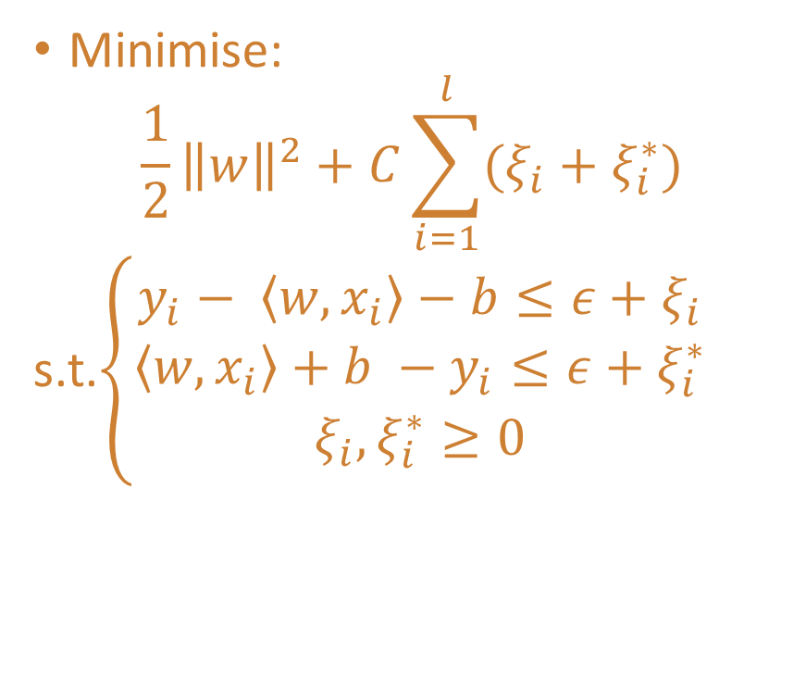
Introduction: Overview
General introduction of Classification and Regression
Toy problems for ease of visualisation/discussion
Kaggle data – open problems:
Classification – Titanic data set
Regression – House price data
Practical guide to algorithms – even if you’re not using SVM!
Minimise:
$$\frac{1}{2}{\left\|w\right\|}^{2}+C\sum_{i=1}^{l}{(ξ_{i}+ξ_{i}^{∗})}$$
s.t.$\left\{\begin{matrix}y_{i}− \left\langle w,x_{i}\right\rangle −b≤ε+ξ_{i} \\ \left\langle w,x_{i}\right\rangle +b −y_{i}≤ε+ξ_{i}^{∗} \\ ξ_{i}, ξ_{i}^{∗}≥0\end{matrix}\right.$

Slide 15
Classification
Predicting discrete outcomes

Slide 16
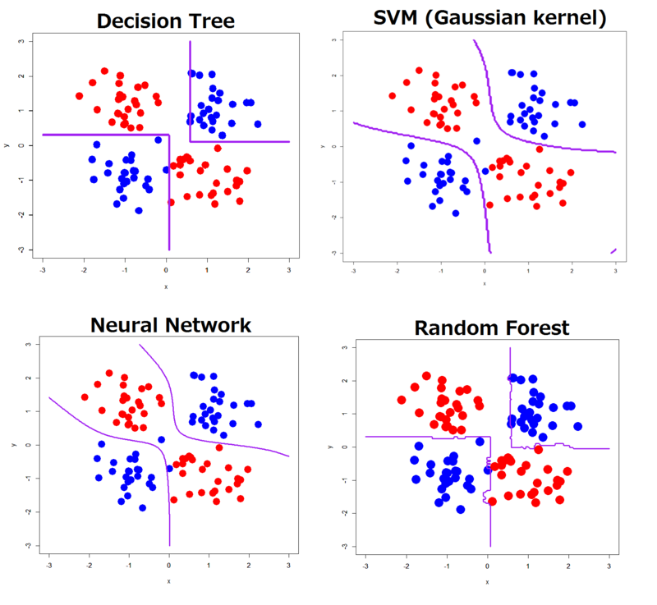
Classification: Overview
Construct mapping from input variables to binary (or multi-class) outcome flag
Visualisation via Decision Boundary
Line in 2-D
Plane in 3-D
Generally referred as a “hyperplane” – hard to visualise
https://www.kdnuggets.com/2015/06/decision-boundaries-deep-learning-machine-learning-classifiers.html

Slide 17
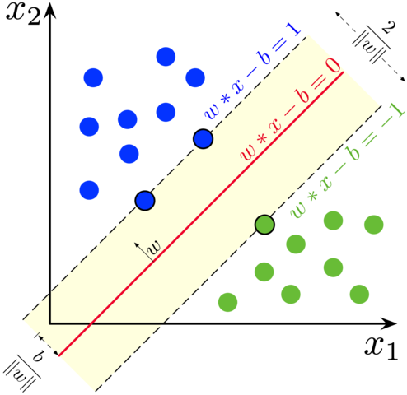
Classification: Support Vectors
Seek separation of values by line/plane/hyperplane
Two-dimensional example is easiest to graph ☺
Maximise minimal distance from a point to the decision boundary
By Larhmam - Own work, CC BY-SA 4.0, https://commons.wikimedia.org/w/index.php?curid=73710028

Slide 18
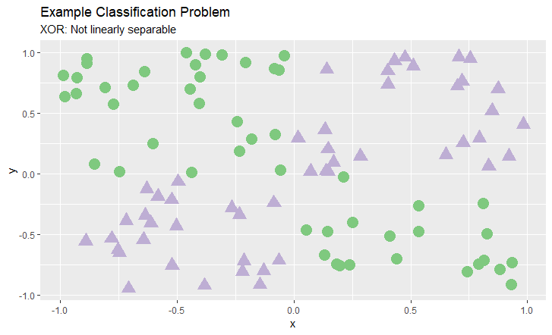
Classification Overview: SVM

Slide 19
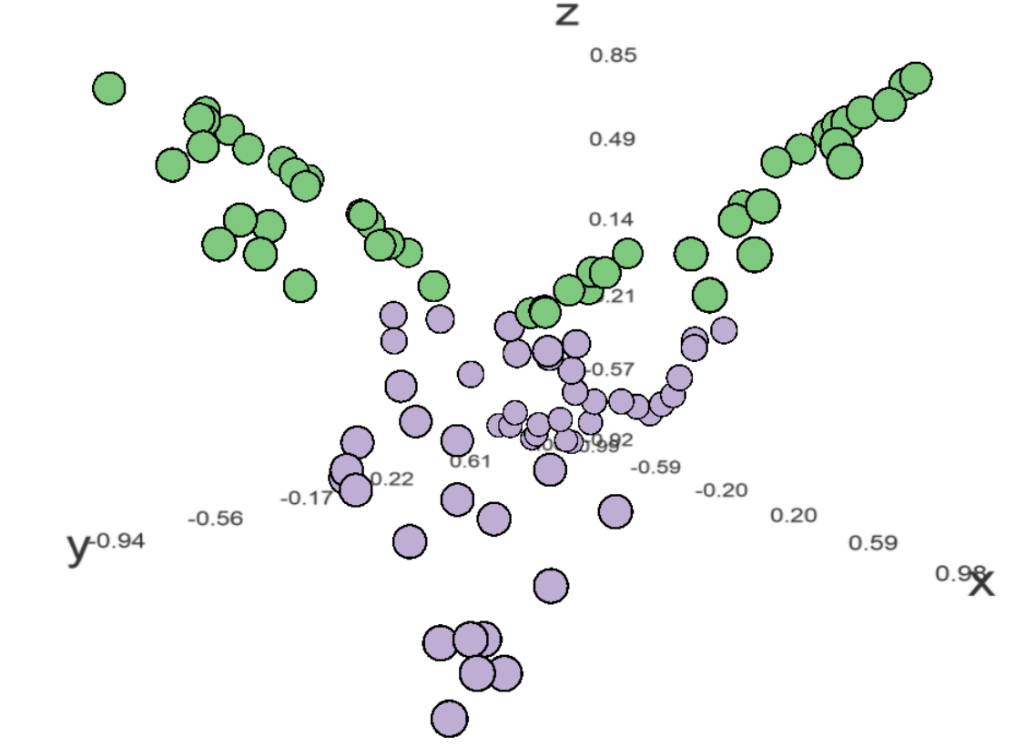
Classification Overview: SVM
z=-xy

Slide 20
Classification Overview: SVM
z=-xy

Slide 21
Support Vector Machines: Classification
Consult experts about additional variables
Expert-driven set of variables
Importance of interaction effects/higher order terms
Leverage expert knowledge, but very rare that they cleanly separate data
Kernels provide an alternate means – to be addressed later
Variable list is a secondary reason….
Primary: Gauge stakeholder engagement

Slide 22



Stakeholder Engagement
Good
Bad
Ugly

Slide 23
Kernels
Kernel Functions
…you don’t need to explicitly map data to a higher dimensional space. You only need to know what the dot products are. The so-called “Kernel trick”
Mathematics for admissible functions
Radial basis functions, polynomials, linear, hyperbolic tangent…
Very important, but I have no insight for you. See what works.
VC Dimension can be used, but it’s a mathematical concept

Slide 24
Regression
Predict a continuous variable

Slide 25
Support Vector Regression
Similar concept:
Project data to higher dimensional space
Find support vectors
Express curve as a function of those support vectors
Often use epsilon invariant cost
Easy to understand
Slope C
ε

Slide 26
Support Vector Regression: Options
“Epsilon” (ε)
“Nu” (ν)
Standard data science view of the world:
I want the best possible function. Use whatever complexity is required.
Use a higher dimensional space and more support vectors to minimise cost
Frequent management view of the world:
We have constrained resources. Do the best you can with what we have.
Limits the fraction of support vectors to ν.

Slide 27
Demo: Parameter Tuning
R and shiny

Slide 28
Real Problems
Ongoing Kaggle Competitions

Slide 29
Classification: Titanic Survival
Ongoing Kaggle competition:
(https://www.kaggle.com/c/titanic/)
Data: 11 Independent Variables, Binary Outcome (0/1)
Passenger Class, Age, Gender, # Siblings, # Parents, Fare, Port, Cabin, Ticket ID, Passenger ID, Name
Fit a classifier SVM to the data
Hard to visualise – how to test with stakeholders?

Slide 30
Titanic Survival: Test
Class | Gender | Age | Siblings | Parents | Fare | Port | Estimate?
1 | Male | 45 | 0 | 0 | 26.60 | S
3 | Female | 24 | 0 | 0 | 8.85 | S
3 | Male | 25 | 0 | 0 | 7.05 | S
3 | Female | 9 | 1 | 1 | 15.20 | C
3 | Female | 19 | 0 | 0 | 7.88 | Q
1 | Male | 28 | 0 | 0 | 35.5 | S
2 | Female | 24 | 2 | 1 | 27.00 | S
3 | Male | N/A | 0 | 0 | 6.86 | Q
2 | Male | N/A | 0 | 0 | 0 | S

Slide 31
Titanic Survival: Model
Class | Gender | Age | Siblings | Parents | Fare | Port | Estimate
1 | Male | 45 | 0 | 0 | 26.60 | S | 1
3 | Female | 24 | 0 | 0 | 8.85 | S | 1
3 | Male | 25 | 0 | 0 | 7.05 | S | 0
3 | Female | 9 | 1 | 1 | 15.20 | C | 0
3 | Female | 19 | 0 | 0 | 7.88 | Q | 1
1 | Male | 28 | 0 | 0 | 35.5 | S | 1
2 | Female | 24 | 2 | 1 | 27.00 | S | 1
3 | Male | N/A | 0 | 0 | 6.86 | Q | 0
2 | Male | N/A | 0 | 0 | 0 | S | 0

Slide 32
Titanic Survival: Assessment
Class | Gender | Age | Siblings | Parents | Fare | Port | Estimate? | Outcome
1 | Male | 45 | 0 | 0 | 26.60 | S | 1 | 0
3 | Female | 24 | 0 | 0 | 8.85 | S | 1 | 0
3 | Male | 25 | 0 | 0 | 7.05 | S | 0 | 0
3 | Female | 9 | 1 | 1 | 15.20 | C | 0 | 0
3 | Female | 19 | 0 | 0 | 7.88 | Q | 1 | 1
1 | Male | 28 | 0 | 0 | 35.5 | S | 1 | 1
2 | Female | 24 | 2 | 1 | 27.00 | S | 1 | 1
3 | Male | N/A | 0 | 0 | 6.86 | Q | 0 | 0
2 | Male | N/A | 0 | 0 | 0 | S | 0 | 0

Slide 33
Titanic Survival: Assessment
Class | Gender | Age | Siblings | Parents | Fare | Port | Estimate? | Outcome
1 | Male | 45 | 0 | 0 | 26.60 | S | 1 | 0
3 | Female | 24 | 0 | 0 | 8.85 | S | 1 | 0
3 | Male | 25 | 0 | 0 | 7.05 | S | 0 | 0
3 | Female | 9 | 1 | 1 | 15.20 | C | 0 | 0
3 | Female | 19 | 0 | 0 | 7.88 | Q | 1 | 1
1 | Male | 28 | 0 | 0 | 35.5 | S | 1 | 1
2 | Female | 24 | 2 | 1 | 27.00 | S | 1 | 1
3 | Male | N/A | 0 | 0 | 6.86 | Q | 0 | 0
2 | Male | N/A | 0 | 0 | 0 | S | 0 | 0
Overall:
84.2% (Train)
78.9% (Test)

Slide 34
Regression: House Prices
Kaggle Data Set, House Prices from Ames, Iowa, USA
(https://www.kaggle.com/c/house-prices-advanced-regression-techniques)
81 Independent Variables, Continuous Outcome (Price)
…I’m not going to list all 81 variables
Mix of Discrete (YearBuilt), Continuous (LotArea), Categorical (BldgType)
Missing values, outliers, small representation (e.g. Neighbourhood)

Slide 35
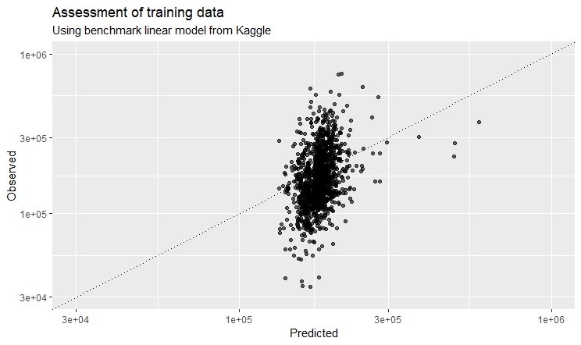
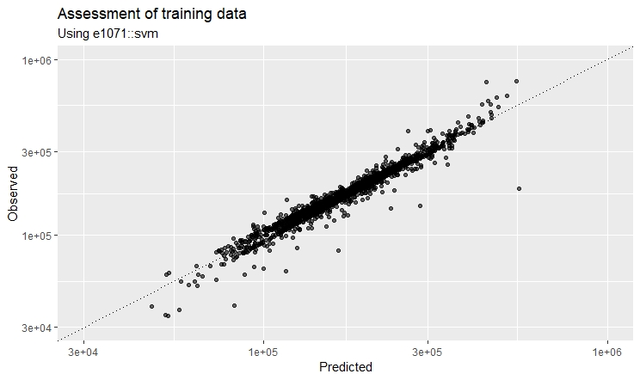
House Prices
Baseline Model
SVM

Slide 36
House Prices: Impact
Baseline Model
SVM
?
?

Slide 37
Conclusion
You can observe a lot by just watching.
– Yogi Berra

Slide 38
Practical Aspects of Data Science
Stakeholder engagement
Negotiations
Active Listening
Practice!

Slide 39
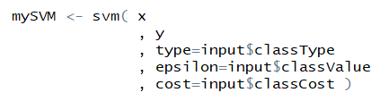
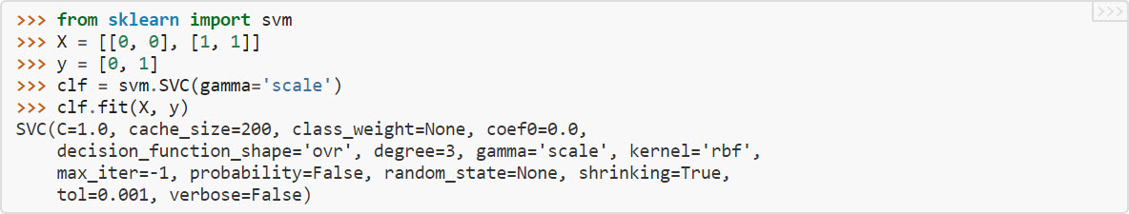
Practical Aspects of Data Science
Stakeholder engagement
Negotiations
Active Listening
Practice!
Mathematics isn’t as important as you might think!
Minimise:
$$\frac{1}{2}{\left\|w\right\|}^{2}+C\sum_{i=1}^{l}{(ξ_{i}+ξ_{i}^{∗})}$$
s.t.$\left\{\begin{matrix}y_{i}− \left\langle w,x_{i}\right\rangle −b≤ε+ξ_{i} \\ \left\langle w,x_{i}\right\rangle +b −y_{i}≤ε+ξ_{i}^{∗} \\ ξ_{i}, ξ_{i}^{∗}≥0\end{matrix}\right.$

Slide 40
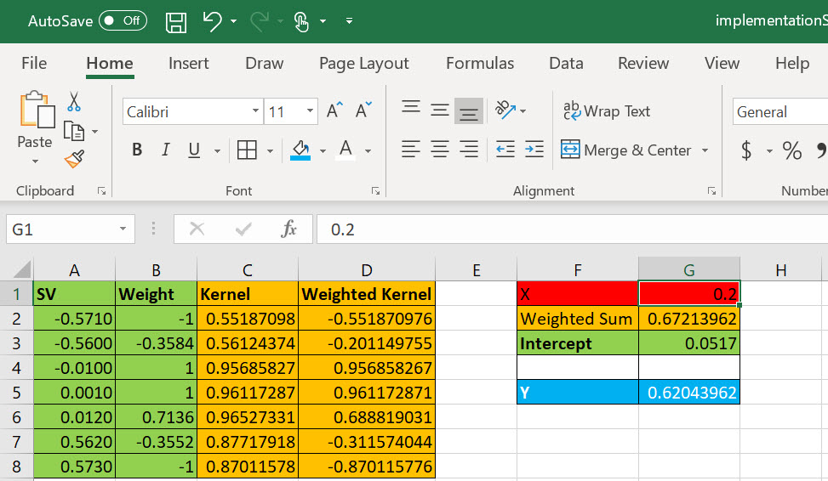
Practical Aspects of Data Science
Stakeholder engagement
Negotiations
Active Listening
Practice!
Mathematics isn’t as important as you might think!
Programming isn’t as important as you might think!

Slide 41
Practical Aspects of Data Science
Stakeholder engagement
Negotiations
Active Listening
Practice!
Mathematics isn’t as important as you might think!
Programming isn’t as important as you might think!
Problems aren’t technical,
they’re human

Slide 42
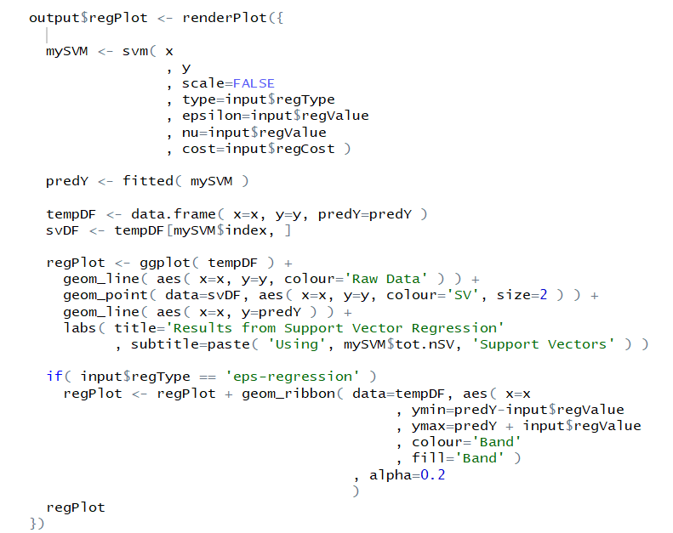
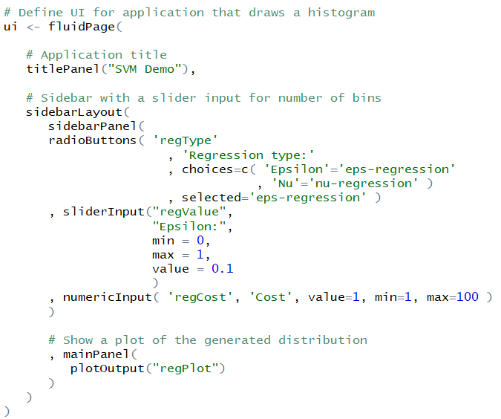
Practical Aspects of Data Science
Stakeholder engagement
Negotiations
Active Listening
Practice!
Mathematics isn’t as important as you might think!
Programming isn’t as important as you might think!
Problems aren’t technical,
they’re human

Slide 43
Summary
This was an introduction to Support Vector Machines
…and how I present them to stakeholders
Perhaps you’re unconvinced
What aspects about your favourite algorithms do you prefer?
Do you have a strategy to explain them?
Stakeholder management is where I spend most of my time
Meetings
Reports
Presentations
Try to wrap these together! (See Breaking the Bottleneck)

Slide 44
Resources
General:
Duda, Richard O., Hart, Peter E., and David G. Stork. Pattern Recognition. 2nd Ed. Wiley. 2000.
Schmarzo, Bill. “The Art of Thinking Like a Data Scientist.” Independent publication.
Wikipedia for introduction and further reading:
General SVM: https://en.wikipedia.org/wiki/Support-vector_machine
Kernel methods: https://en.wikipedia.org/wiki/Kernel_method
VC Dimension: https://en.wikipedia.org/wiki/Vapnik%E2%80%93Chervonenkis_dimension
Podcasts
Data Camp: https://www.datacamp.com/community/podcast
Data Futurology: https://www.datafuturology.com/podcast

Slide 45
Where you can find me
LinkedIn (Craig Savage)
https://www.linkedin.com/in/craig-doc-savage
Kaggle (Craig “Doc” Savage)
https://www.kaggle.com/docsavage
YouTube (DocSavage)
https://goo.gl/Mjp6Sc
GitHub (SavageDoc)
https://github.com/SavageDoc/

Slide 46
Acknowledgements
Microsoft
Hosting this event
Kaggle
Data, kernels, community
Giphy.com
So many gifs, so little time….

Slide 47

Acknowledgements
Microsoft
Hosting this event
Kaggle
Data, kernels, community
Giphy.com
So many gifs, so little time….

Slide 48
Thank you
Citizen Data Scientists – Melbourne
Presented by Craig “Doc” Savage

